Slide 1
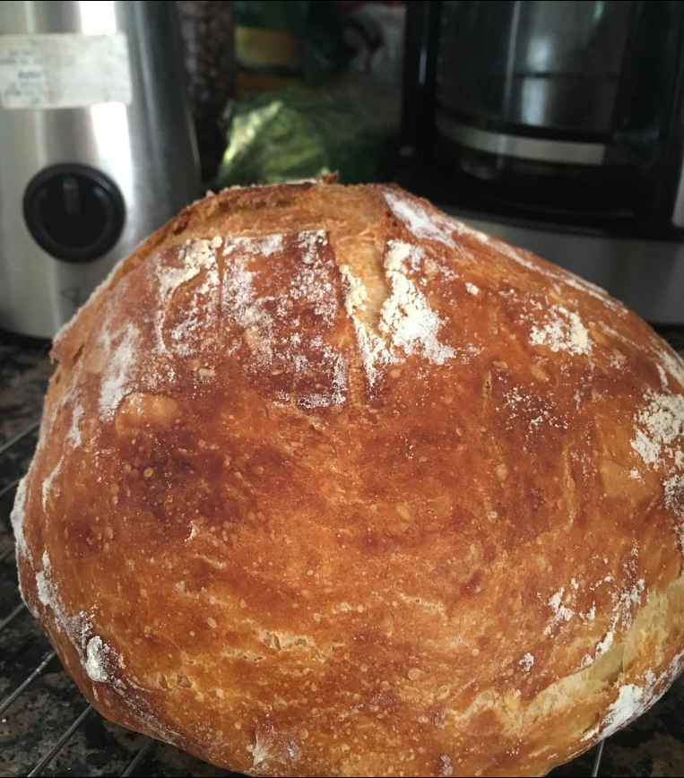
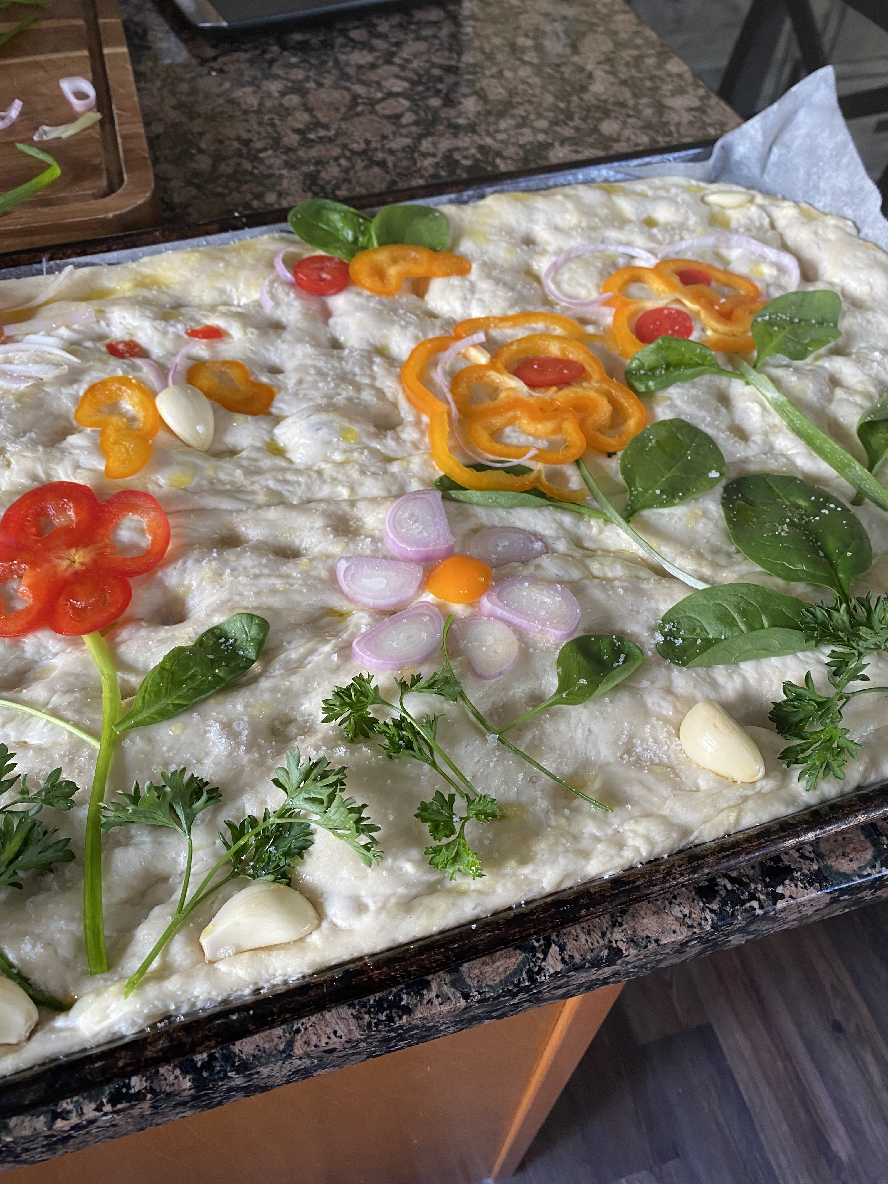
Notes:
The picture on the left was taken August 2017, and was my very first “good” loaf of bread – a no-knead dutch oven loaf. The picture on the right was taken October 2022 and is my most recent creation – a delightful and delicious garden focaccia. ‘Bready’ or not, here ‘crumb’ 5 years of my bread making adventures.

Slide 2
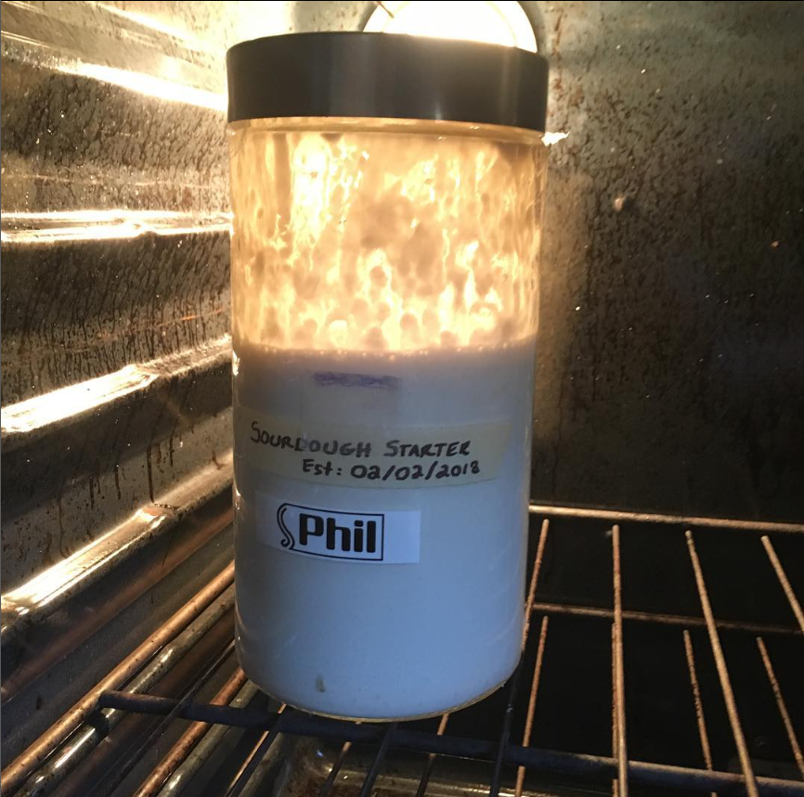
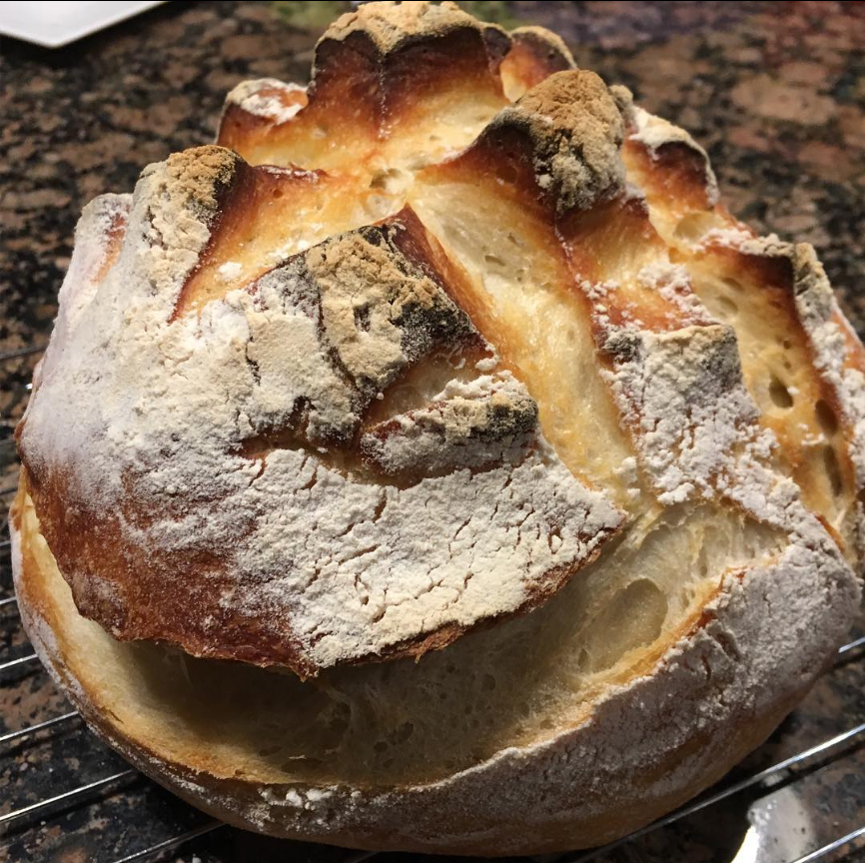
Notes:
On groundhog day of 2018 my starter, Phil, was born. Named in honour of Puxatawney Phil who had passed on that same day. I had been to san-Francisco once and wanted to recreate some of that sourdough goodness at home. The first one of Phil’s “Phildren” is on the right, dense yet delicious. I was hooked and I had to make more!

Slide 3
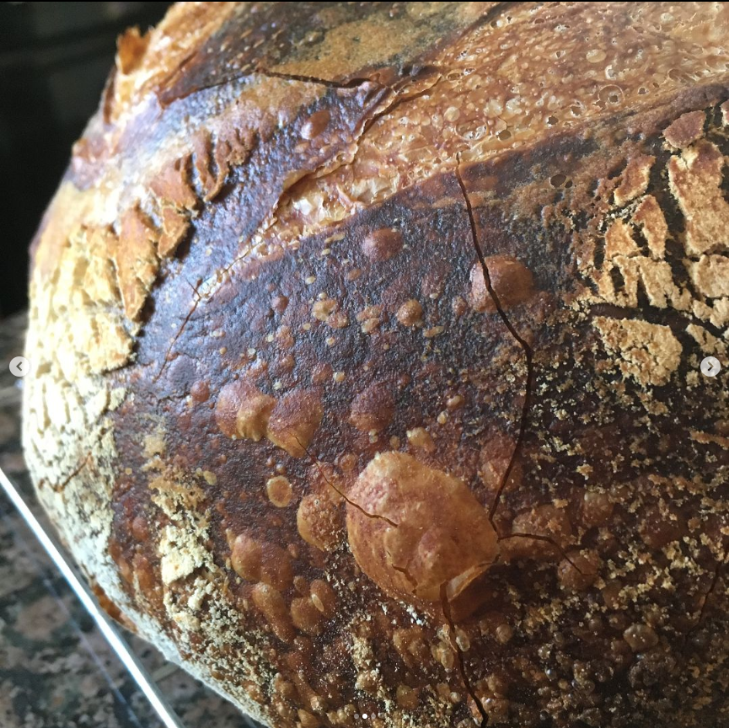
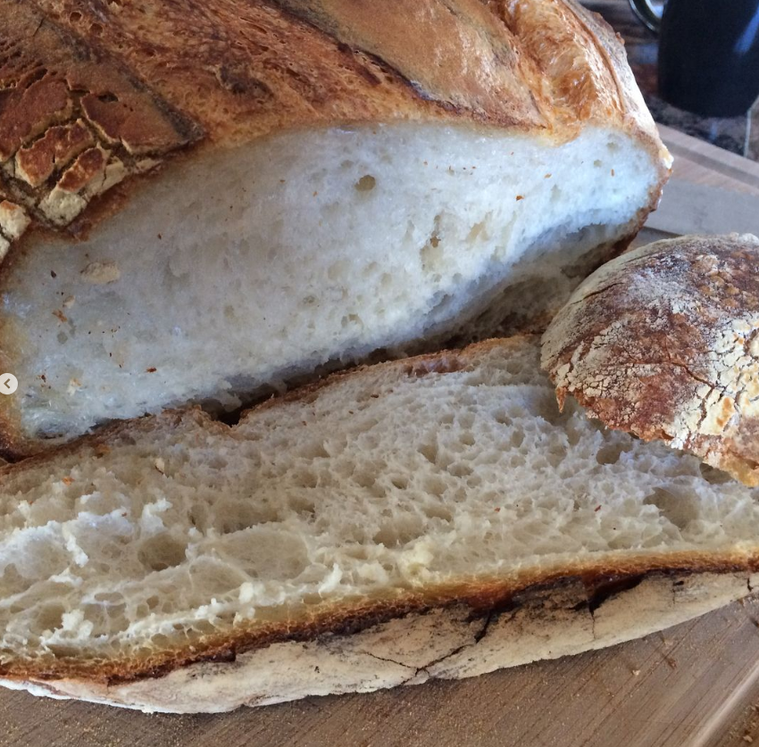
Notes:
In Phil’s early days I spent my time trying different recipes and techniques, just with regular white flour at this point. On the left is the first really good ‘crispy’ bubble I got on a loaf of 100% white, and on the right is the first ‘crumb shot’ from the same loaf. I was proud of myself but I knew I could do better and that I had a lot to learn. Little did I know…

Slide 4
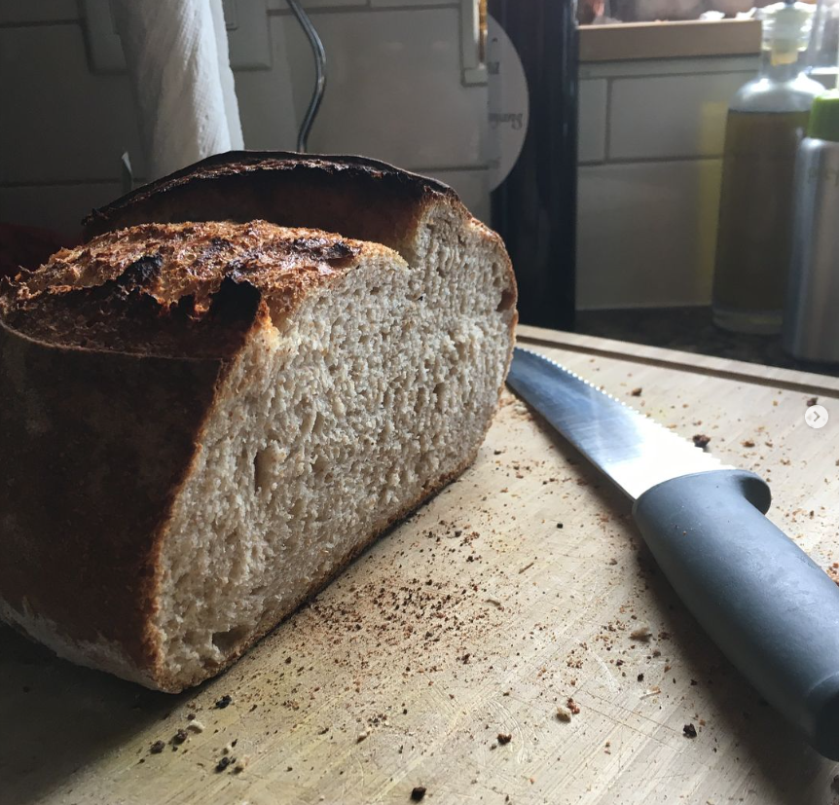
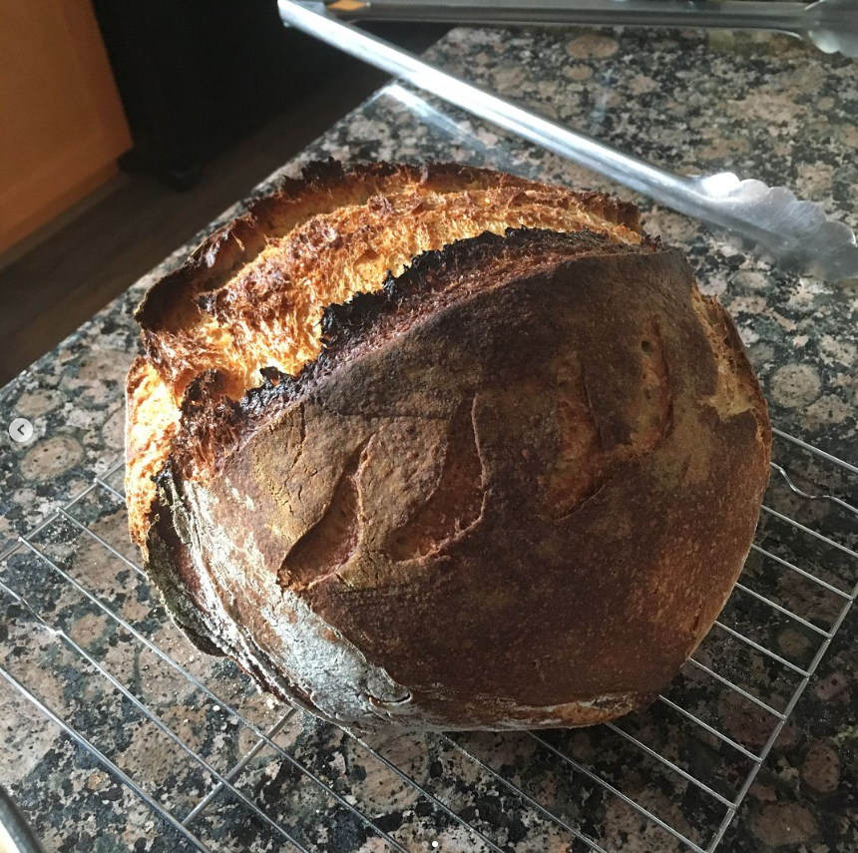
Notes:
The next loaf was even better yet, but absent of any really big air bubbles. On the right you can see where I tried my hand at making a few leaf patterns, they were so bad I stopped trying decorative scoring for a while. Perhaps sourdough was a bit harder than it looked. I had to do more research! It couldn’t be that difficult, could it?

Slide 5
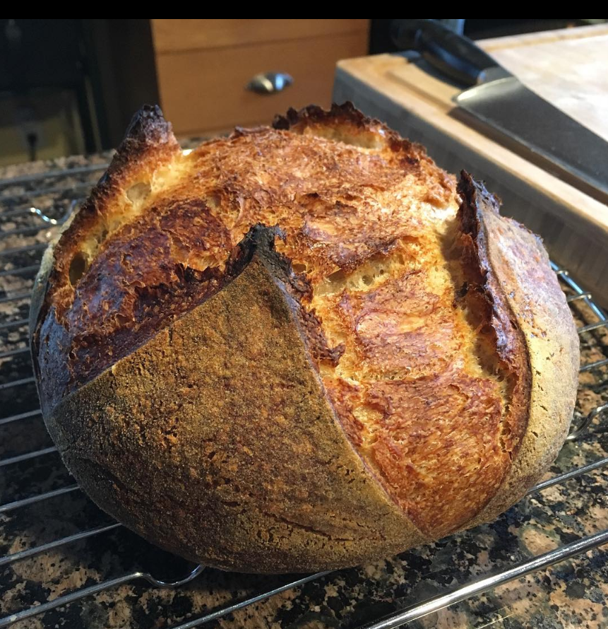
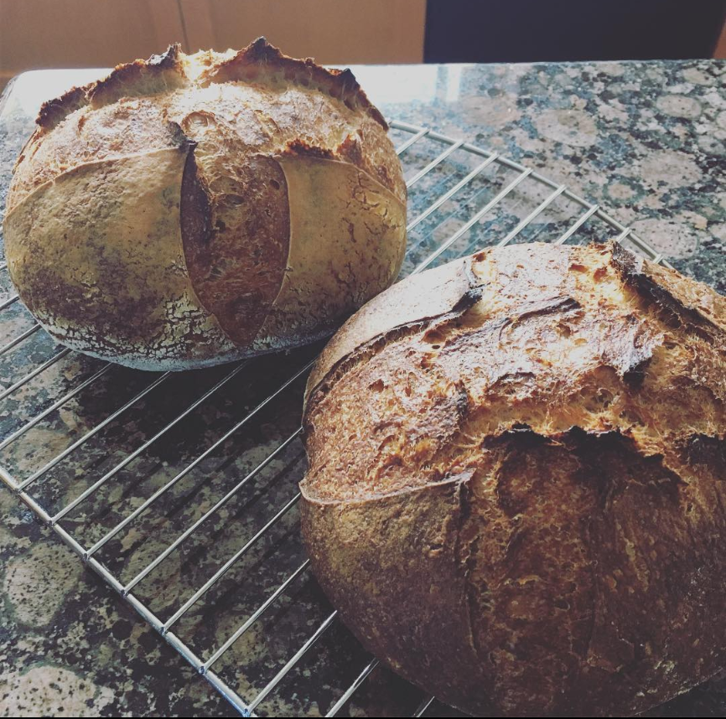
Notes:
I quickly came to realize that the internet was awash with 1000 different ways to make bread ‘the correct’ way. Some recipes said only use bottled water (yeah right), some recipes insisted upon specific ways of stretching and folding the dough to build gluten. It seemed for every bubble of yeast in my bowl there was a different piece of advice.

Slide 6
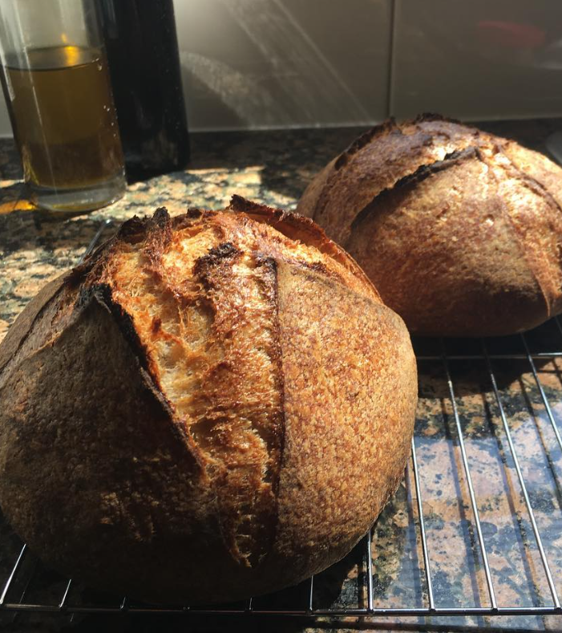
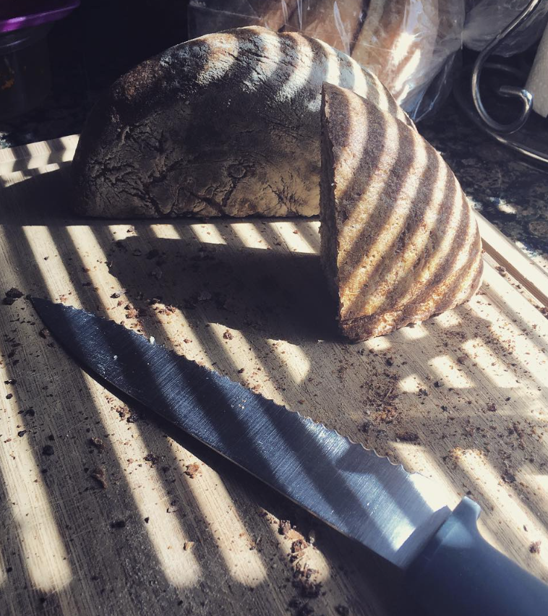
Notes:
I settled on a youtuber named “Alex the French guy” to be my guide. Who knows their bread best but the French I thought to myself! Following his advice has honestly produced some of the best and most beautiful loaves I have made, however they take like 2 days to make. My loaves also didn’t quite look like the ones on the internet yet. What was missing?

Slide 7
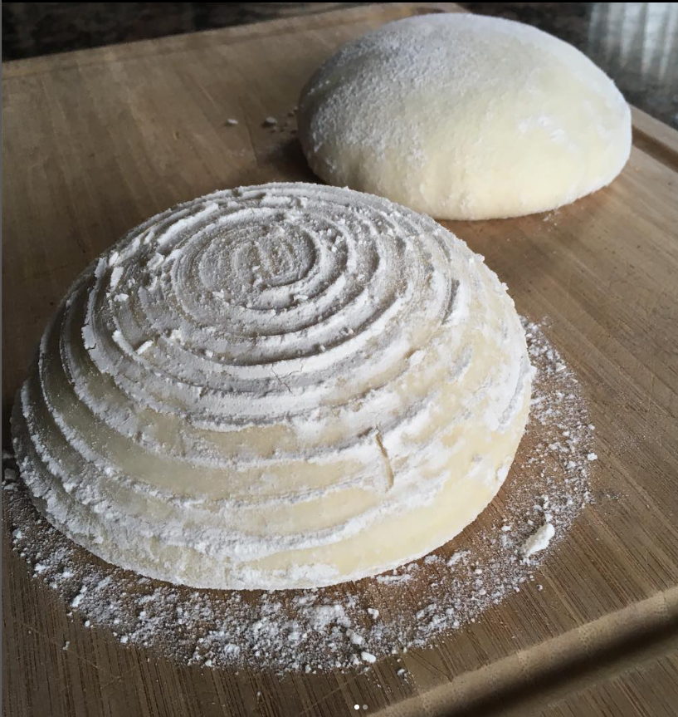
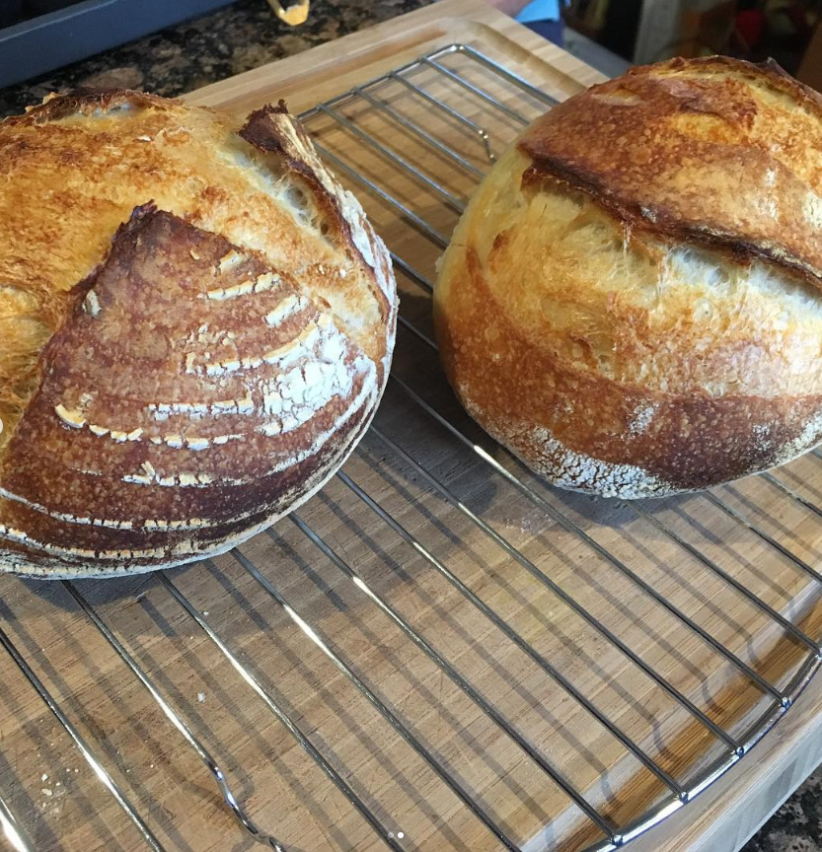
Notes:
I quickly went to my local artisanal cooking store and purchased some bannetons (which are little baskets made of rattan). Now I could get those delightful, concentric flour rings to adorn the outsides of my loaves! Now my bread photos could look pretty without having any weird, misshapen leaf patterns on the outside!

Slide 8
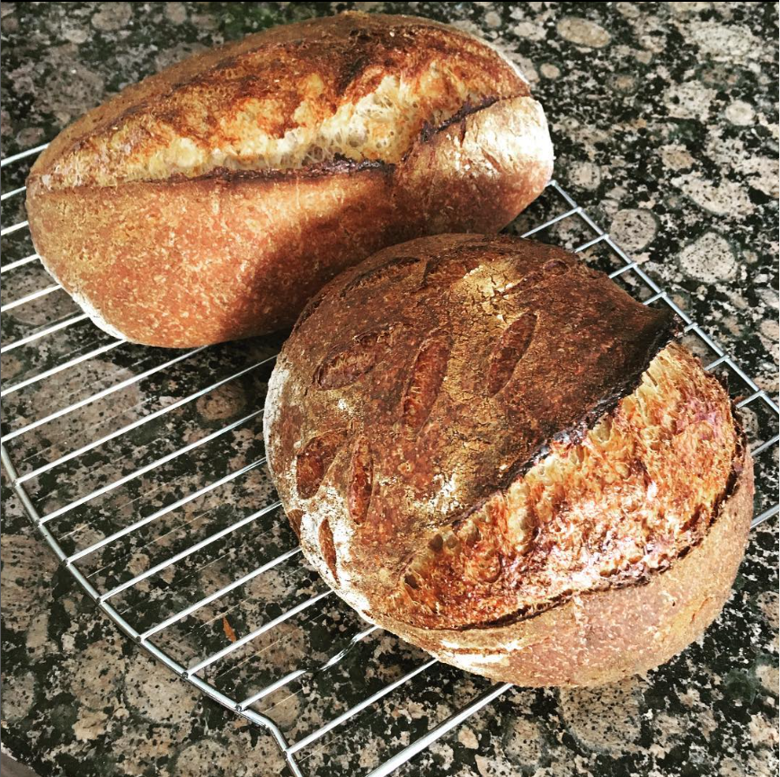
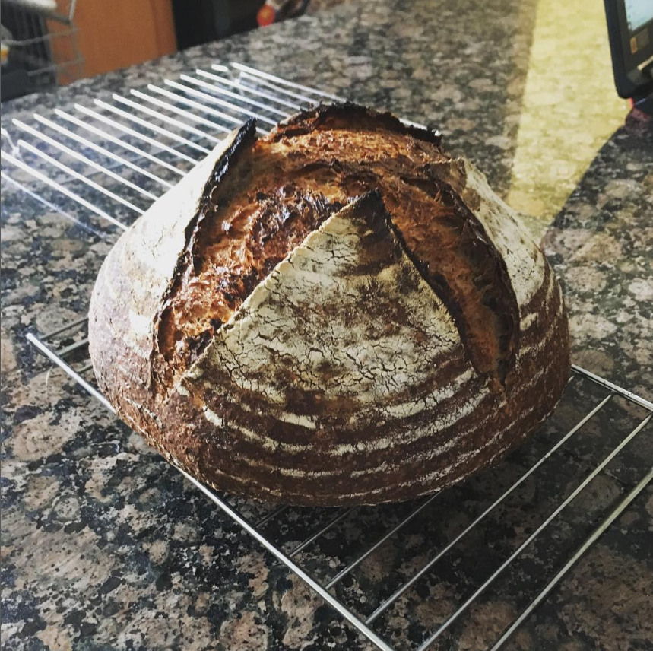
Notes:
Okay, I lied – here are some more weird and misshapen leaf patterns on the left.
I had also started experimenting with types of flours, and much to my wife’s dismay had accumulated 7 types of flour in our pantry already by this point. I finally understood the scene from Stranger Than Fiction where Will Ferrel buys his baking inclined love interest a bunch of ‘flours’. What a great gift!

Slide 9
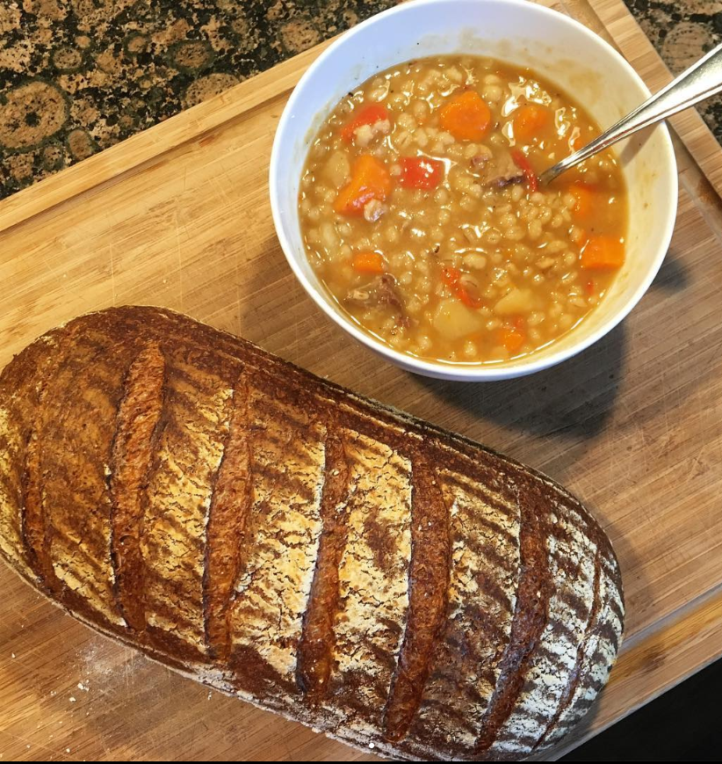
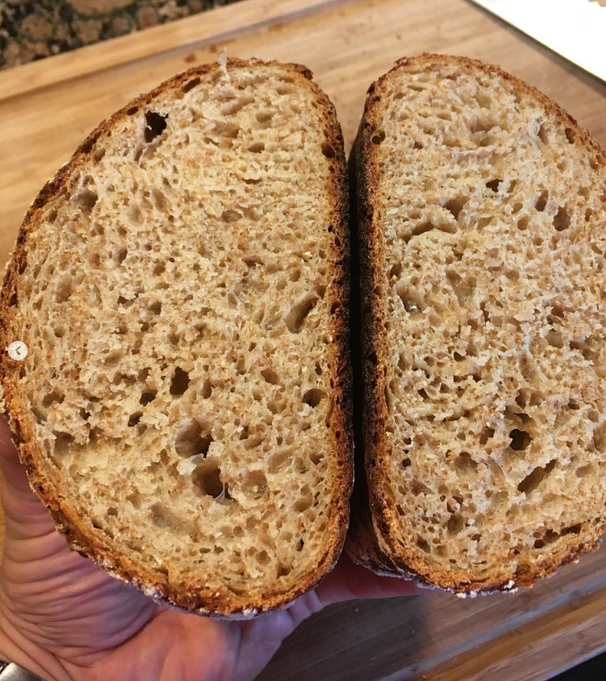
Notes:
My best results I were from 50% whole wheat flour, 40% white flour, 5% rye and 5% spelt. The loaves were chewy yet crisp, sour but not too sour – as whole wheat adds some sweetness back.
My wife and I also found ourselves eating a lot more soups, as what goes better with a fresh loaf of bread than a steaming bowl of soup?

Slide 10
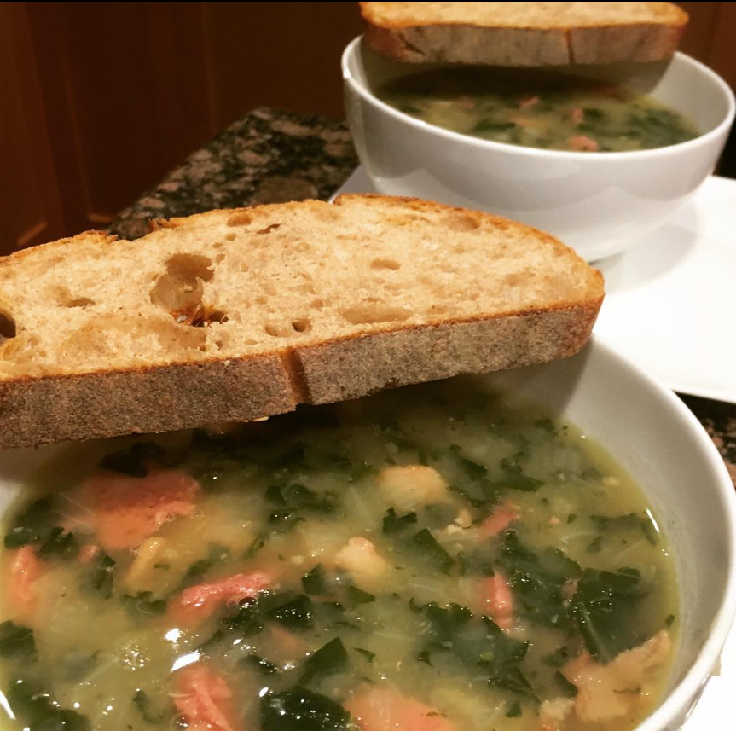
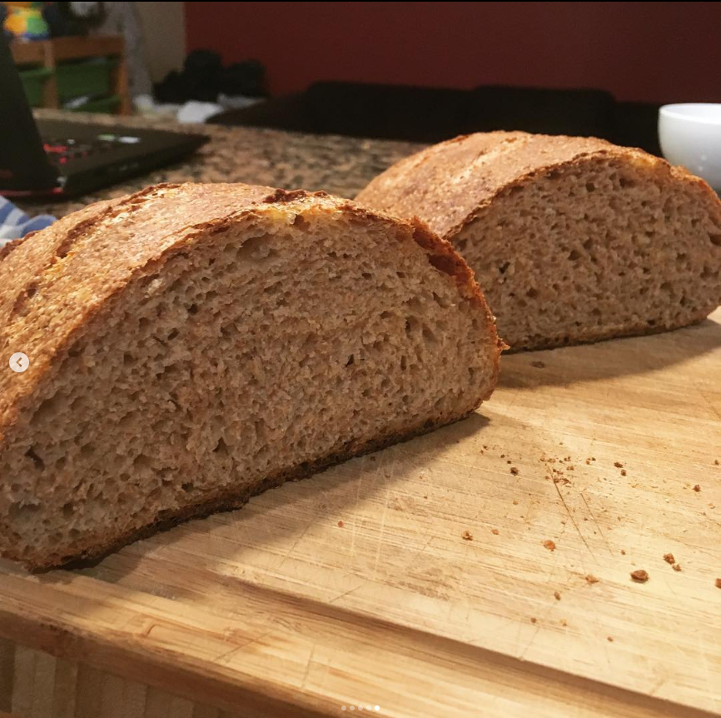
Notes:
Sometimes after I would take a loaf out of the oven, let it cool, and cut into it – I would be disappointed as the texture or flavour or the air bubbles quite weren’t what I expected them to be. Turning that bread into toast however solved most of those problems. Whoever took bread out of the oven the first time and said ‘what if we cook it again?’ was a low key genius.

Slide 11
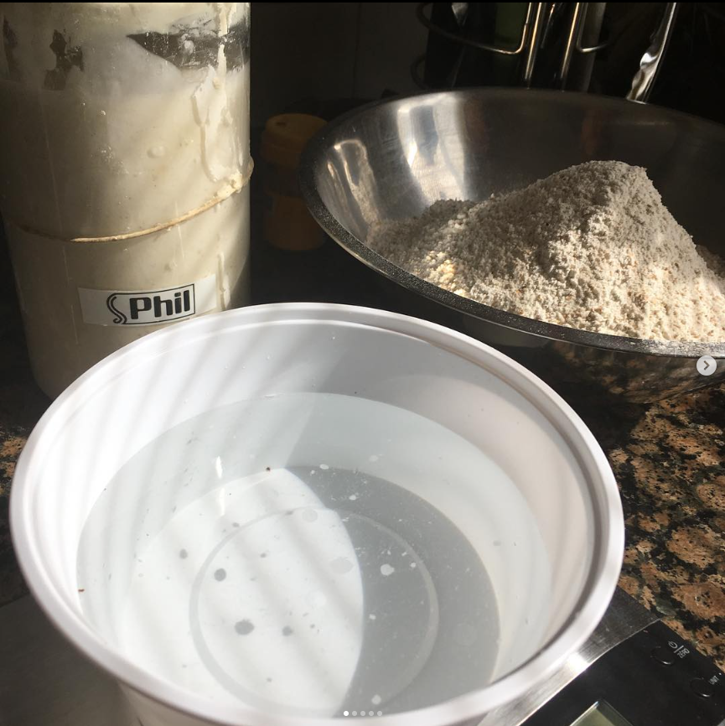
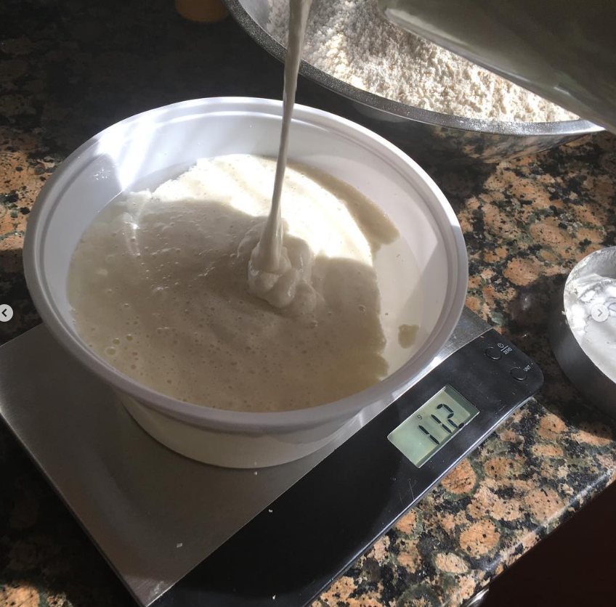
Notes:
Here you can see the beginnings of a loaf on the left, flour, warm water and a happily fed Phil. On the right you can see the ‘float test’ where you can kind of gauge whether you starter is ready by if it floats on top of the water or not. The internet either loves or hates the float test depending on the article you read.

Slide 12
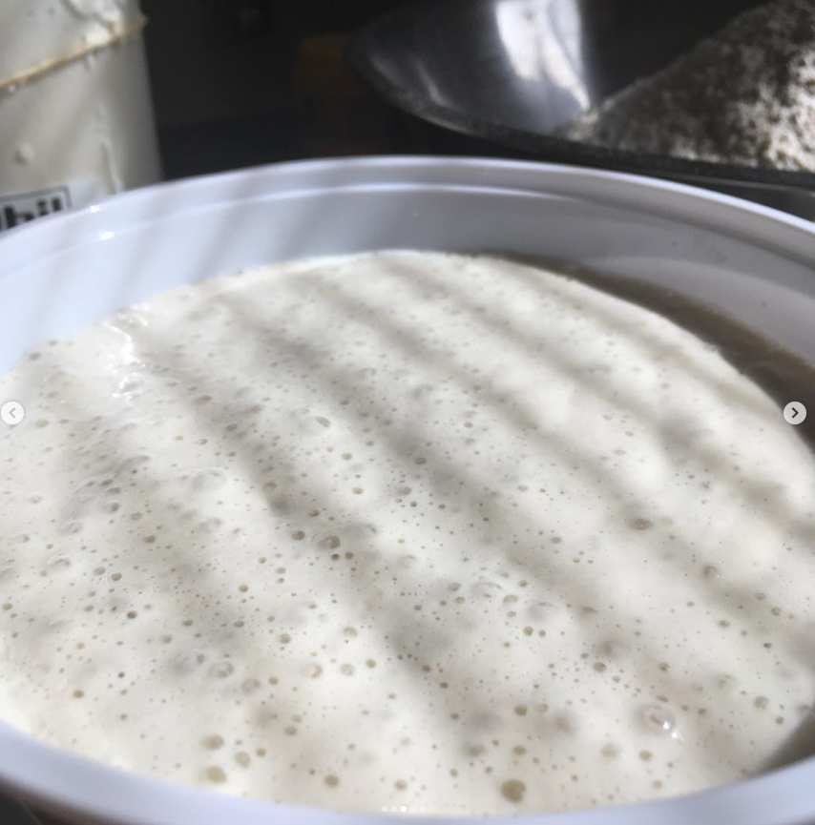
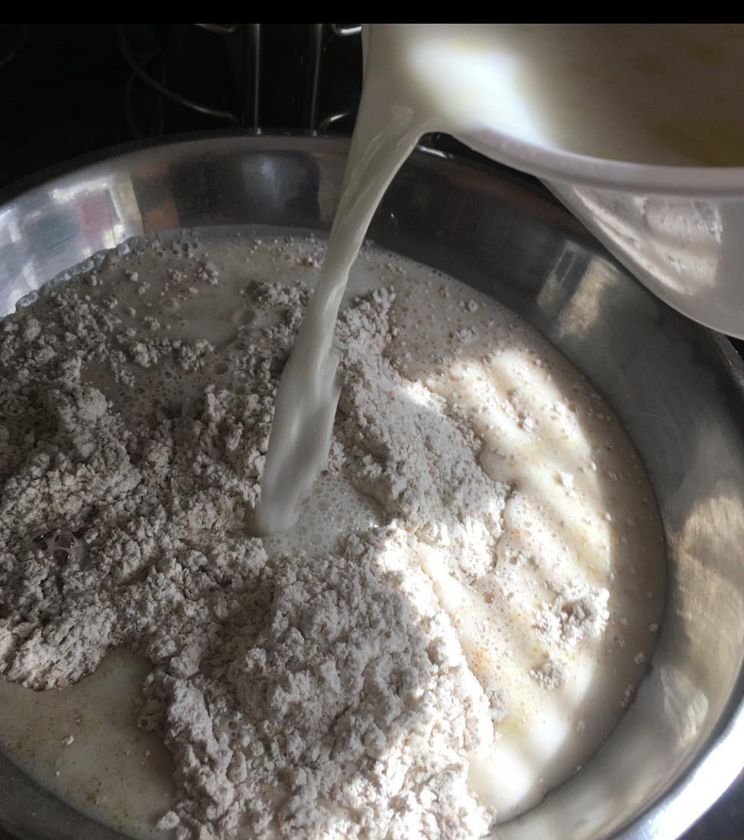
Notes:
Look at all those bubbles! Phil must have eaten well! The next step is simply pouring the warm water and starter into the flour. At this point things already smell delicious because the warm water lets the yeast smell permeate throughout the kitchen. Often my wife would come home and say ‘it smells like a bakery in here’ when I was only at this step!

Slide 13
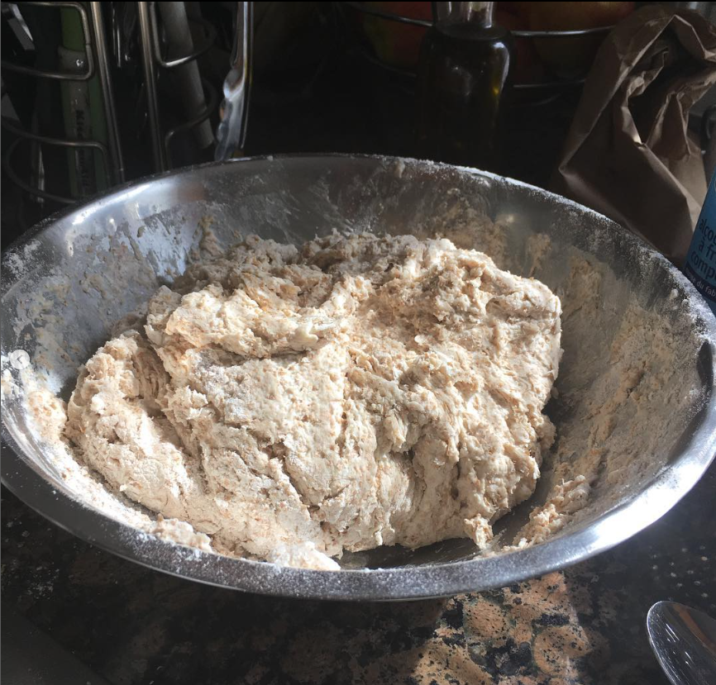
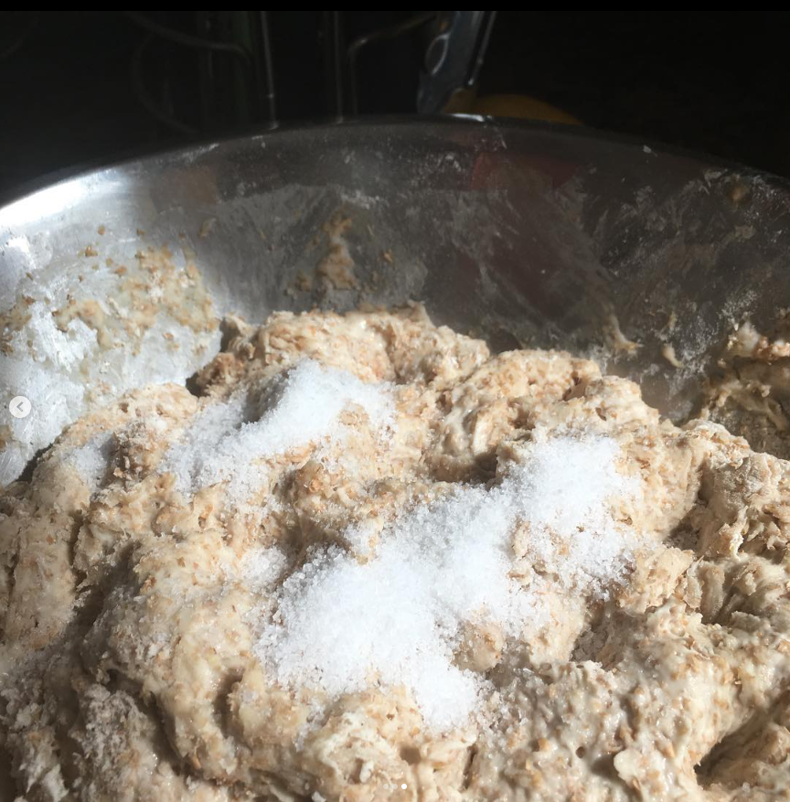
Notes:
After you pour in the water and starter it’s time to get your hands dirty and get all of the water and flour mixed together. The result is known as a ‘shaggy mass’ – you don’t want to overwork the dough here just get the flour all wet. After that you dimple in a few holes with your fingers and add salt, the final ingredient!

Slide 14
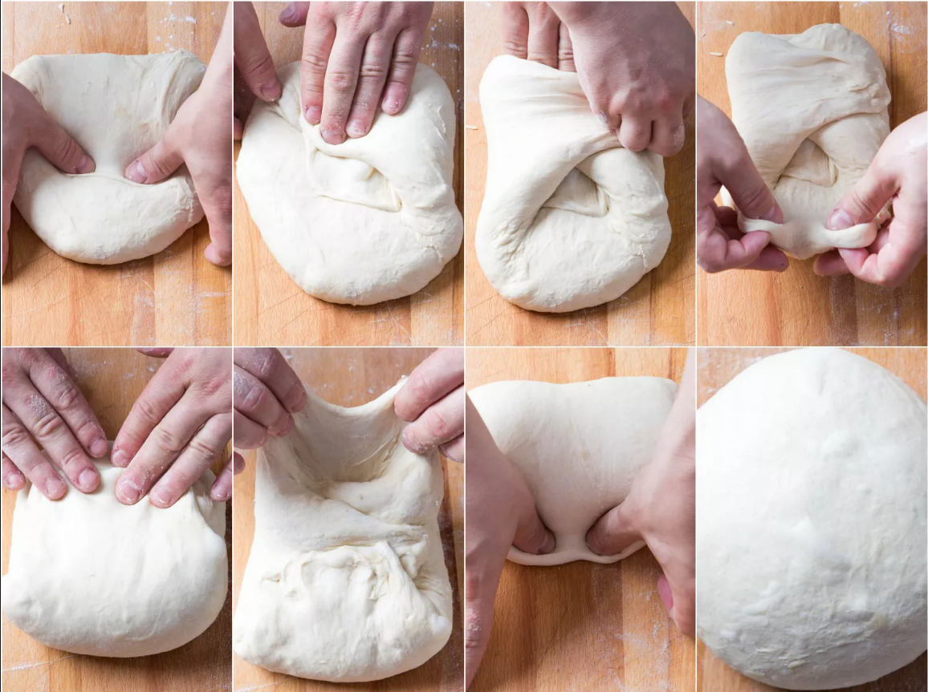
Notes:
After adding the salt it’s time to stretch and fold. Again the internet has at least 5 different methods which as the best way to ‘stretch and fold’ your bread. The entire goal of the process is to build gluten. You are essentially ‘tightening up’ your dough so it can hold it’s own shape when baked. This one is known as the envelope fold.

Slide 15
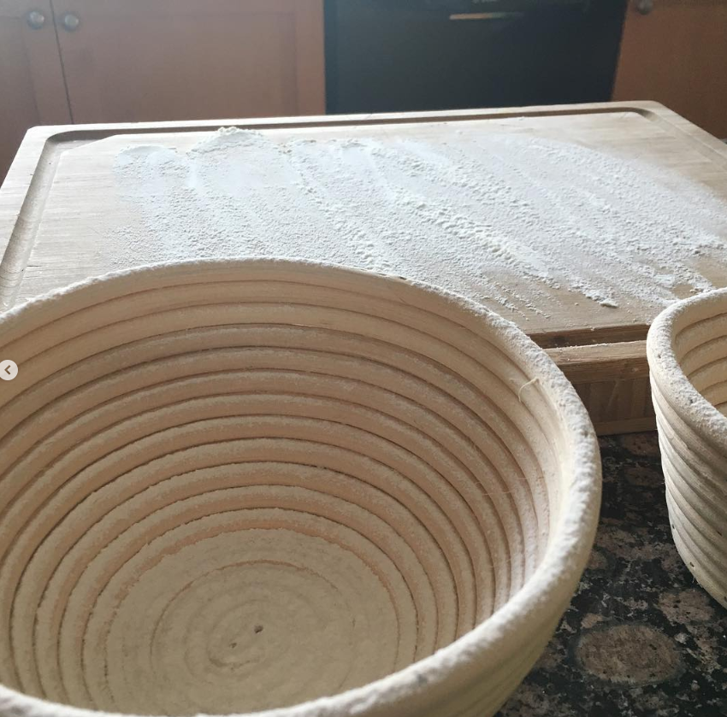
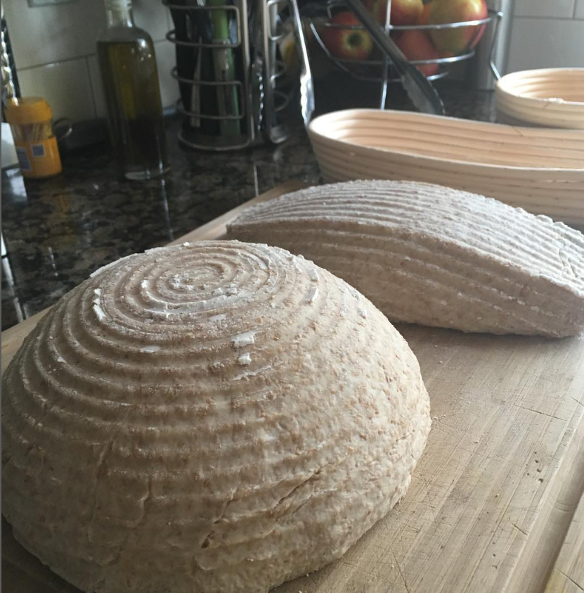
Notes:
After a series of stretches and folds (usually 3-4 sets of folds with 90 minutes between), it’s time for pre shaping – which is where you kind of get the dough into it’s final loaf form, and then let it rise in a basket or banneton. If you don’t have a banneton you can just use a bowl or a pot with a towel in it. The photo on the right is after the loaves were in the fridge for 12 hours.

Slide 16
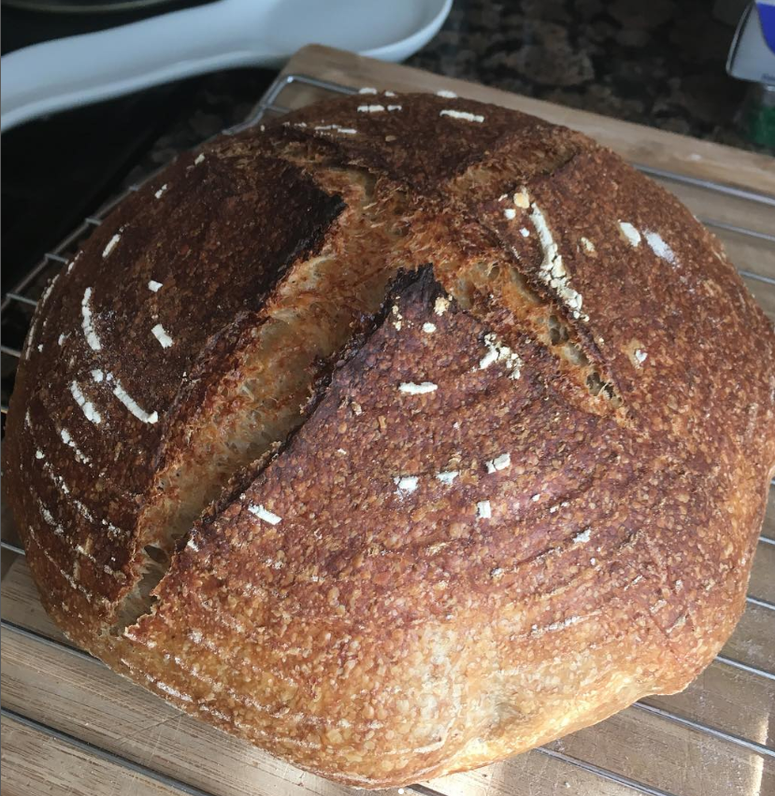
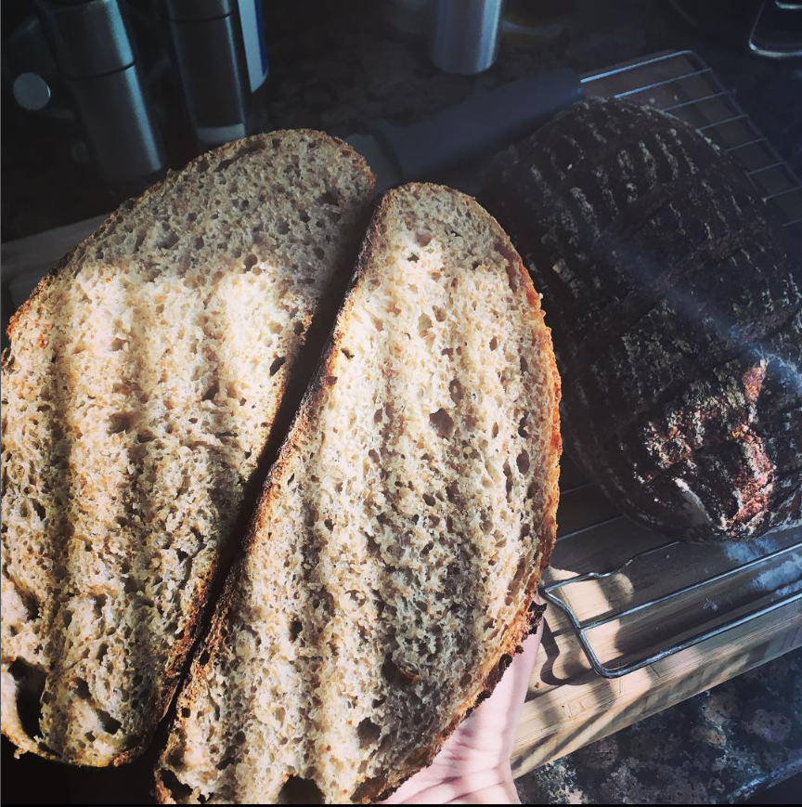
Notes:
The resulting bread from the last 6 slides was this loaf – not very round I guess hmmph. By this point I had come to accept my loaves were maybe not perfect but always still delicious and that was fine by me. Maybe my loaves didn’t need to look like those idyllic loaf influencers on Instagram. Maybe it was time to look at some other breads.

Slide 17
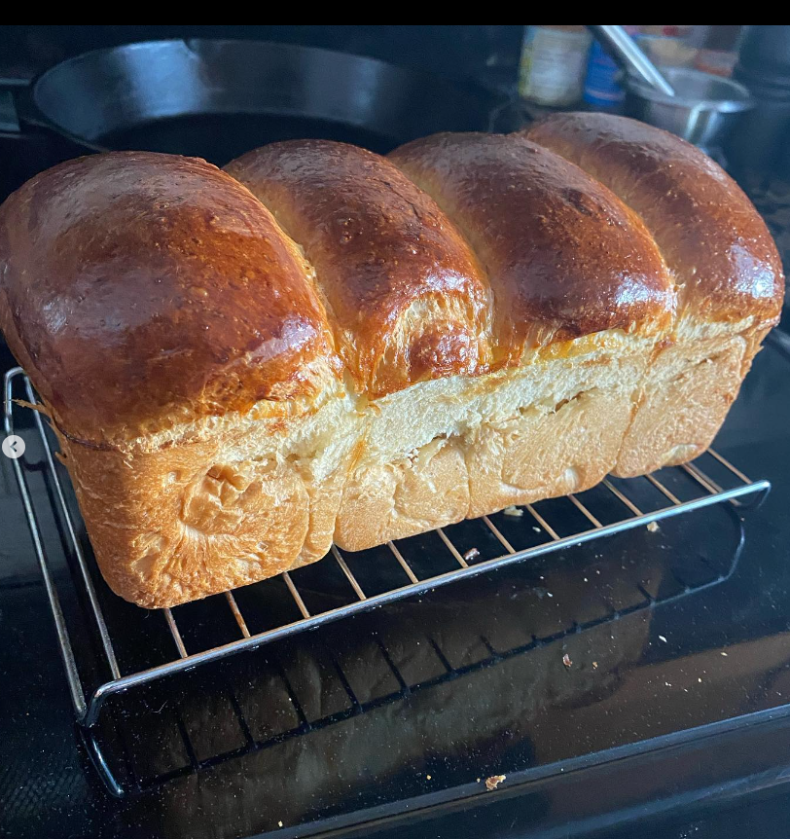
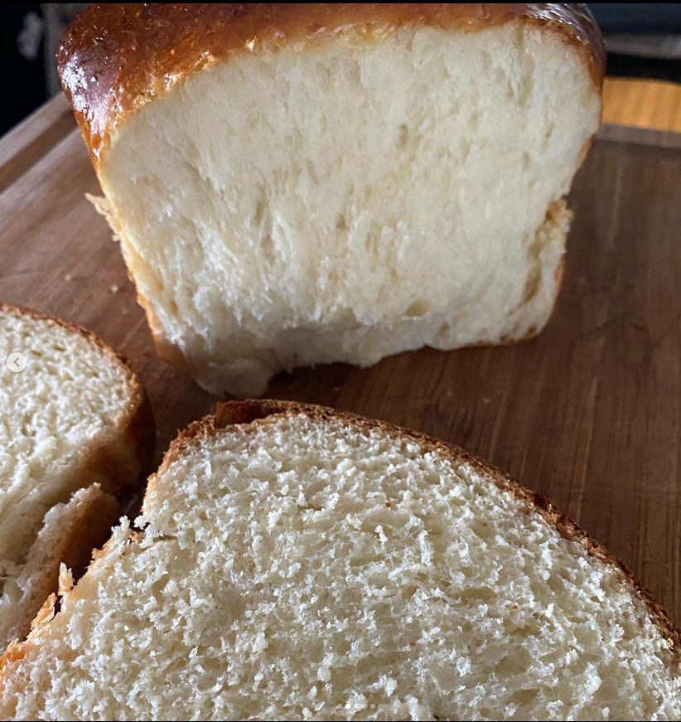
Notes:
Of non-sourdough breads – this is one of my favourite – Hokkaido Milk Bread – sweet, soft and very pull apart-able. You can see the hints of delicate swirls on the sides of the loaves. These come from the method of formation where you create a square of dough first, then roll it into a log before putting in into the loaf pan to rise. That’s also how you make marble rye, by the way!

Slide 18
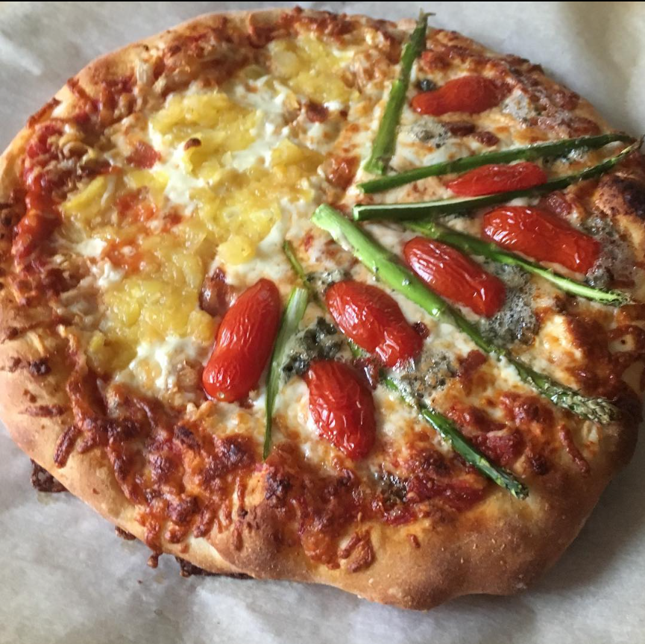
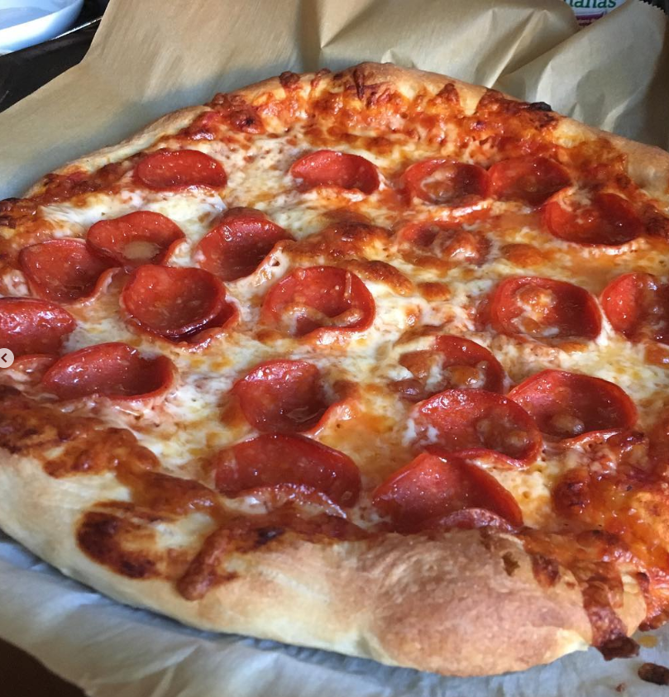
Notes:
Another non sourdough bread that I have enjoyed experimenting with is pizza dough. Stretching and folding? No! Now it’s stretching and throwing! Another bread you can easily spend years chasing perfection on.
After I started experimenting with pizza dough I received a cast iron pizza pan as a gift and still use it often to this day.

Slide 19
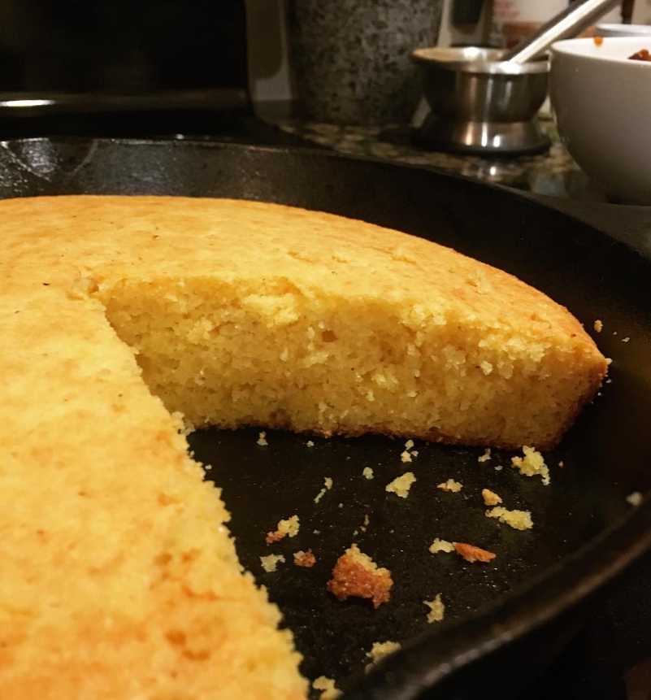
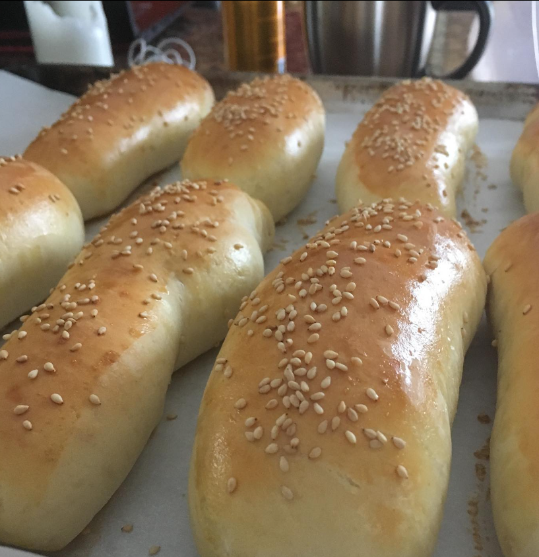
Notes:
What about cornbread? That’s a bread too! A wedge of cast-iron corn bread slathered in chipotle butter is a recipe for deliciousness. And ugly hot dog buns, how fun! Now I could finally experience the sensation of having the same number of hotdog buns as there were hotdogs in a pack. No 10 dogs and 12 buns for this guy, and no preservatives! (well not in the buns).

Slide 20
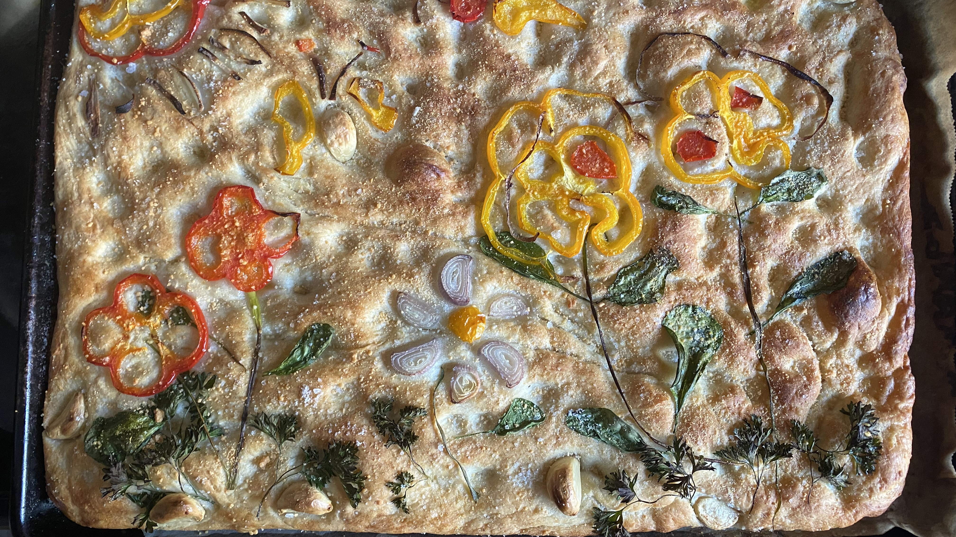
Notes:
Now that we have come back to the garden, I want to leave you with a few dough bits of wisdom.
Bad bread is still usually delicious, and if not – it can be always be made into bread crumbs.
Bread is more forgiving than the internet will have you believe, and
Explore all the types of breads, and don’t be afraid to fail, as this kind failure is delicious!
Thanks for coming to my bread talk.

